Slide 1
Welcome!
2022 Staff Appreciation Event
Hosted by Staff Council and President’s Office
Humboldt is located on the present and ancestral Homeland and unceded territory of the Wiyot Tribe. Tribes and Nations in Humboldt County include Hupa, Karuk, Mattole, Tolowa, Wailaki, Wiyot, and Yurok. We make this land acknowledgment in recognition that our words must be matched by action and approach.
Learn more from Dr. Cutcha Risling Baldy's lecture “What Good Is a Land Acknowledgment?”
Please donate to the Wiyot Tribe Honor Tax:
http://www.honortax.org

Slide 2
Welcome!
2022 Staff Appreciation Event
Hosted by Staff Council and President’s Office
Event Schedule
4:00 pm - Welcome
4:05 pm - Address from the Office of the President
4:20 pm - 10/20 Years of Service Acknowledgment
4:40 pm - Staff Recognition Winners
4:50 pm - Prize Giveaways

Slide 3
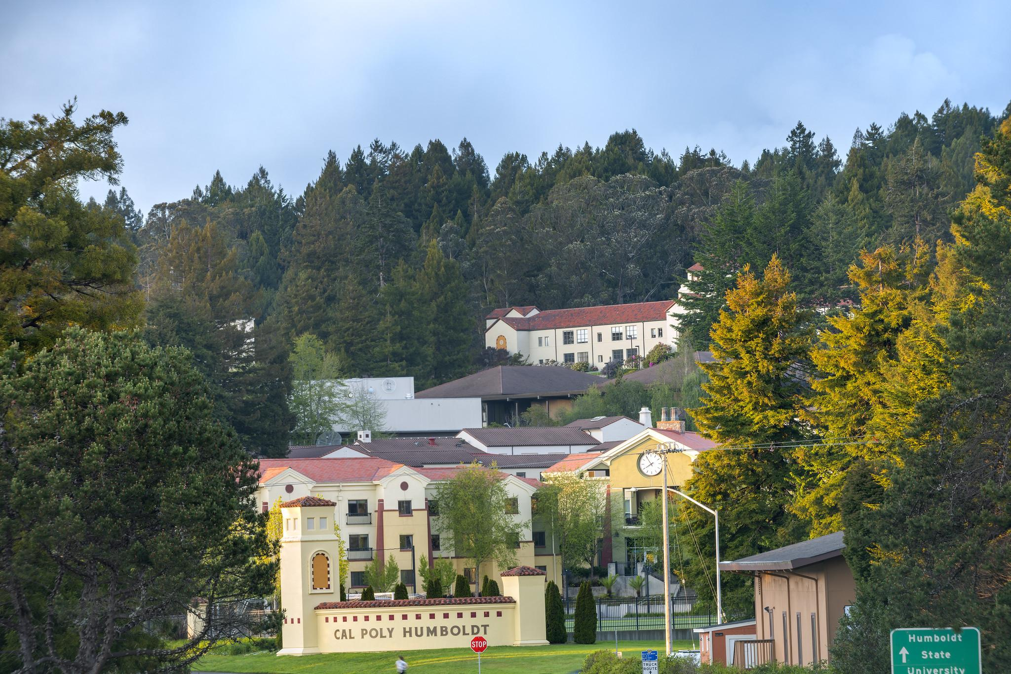

Slide 4
Staff Council - 2021/2022
Sulaina Banks - President
Phil Rouse - Secretary
Deirdre Clem - Counselor
Katie Koscielak - Counselor
Maxine Mota - Counselor
Nancy Olson - Counselor
Kali Rothrock - Counselor
Janessa Woolley - Counselor

Slide 6
10 Years of Service
Amanda Staack - Indian Natural Resource Science & Engineering Program (INRSEP)
Ann Johnson-Stromberg - Small Business Development Center (Norcal SBDC)
Anna Thaler - Academic and Career Advising Center
Anthony Johnson - Sponsored Programs Foundation
Carolyn Ortenburger - Schatz Energy Research Center
Hugh McCaffrey - Marketing & Communications
Jaime Tripp-Carter - Housing
Kelda Quintana - Academic and Career Advising Center
Loren Collins - Academic and Career Advising Center

Slide 7
10 Years of Service
Margaret Griggs - Kinesiology & Recreation Administration
Marguerite Powers - Enrollment Management, Office of the Vice President
Melissa Cook - Student Health and Wellbeing Services
Morgan King - Facilities Management, Sustainability Office
Nathaniel Cacciari-Roy - College of Extended Education & Global Engagement
Sabrina Zink - Risk Management
Sky McKinley - Institutional Research, Analytics, and Reporting
Shawn Thompson - Small Business Development Center (Norcal SBDC)
Tyler Hooker - Physics & Astronomy

Slide 8
20 Years of Service
Marlette Grant-Jackson - Indian Tribal & Educational Personnel Program (ITEPP)

Slide 9
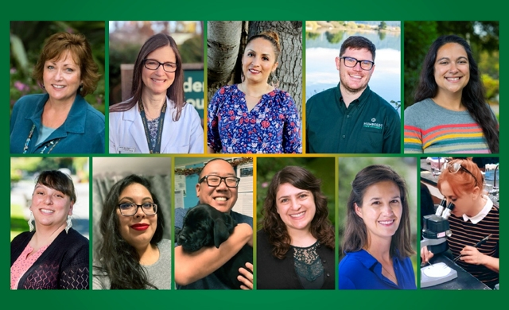
Staff Recognition Winners - 2021/2022

Slide 10
Staff Council 2022/2023
If you are interested in being more involved in our campus community, please consider serving on Staff Council for the 2022-2023 academic year.
Staff Counselor Role (2-year term with optional 3rd year)
Eligibility: A non-academic employee working at least half-time and employed by Humboldt State University or an auxiliary organization
Term Dates: August 1, 2021 - May 30, 2023 (with optional 3rd year)
Time Commitment: Typically 5-10 hours a month

